Slide 1


travel agency
MOUNTEAM
Tokmurzin Mukagali
Tursynbay Aibolat

Slide 2
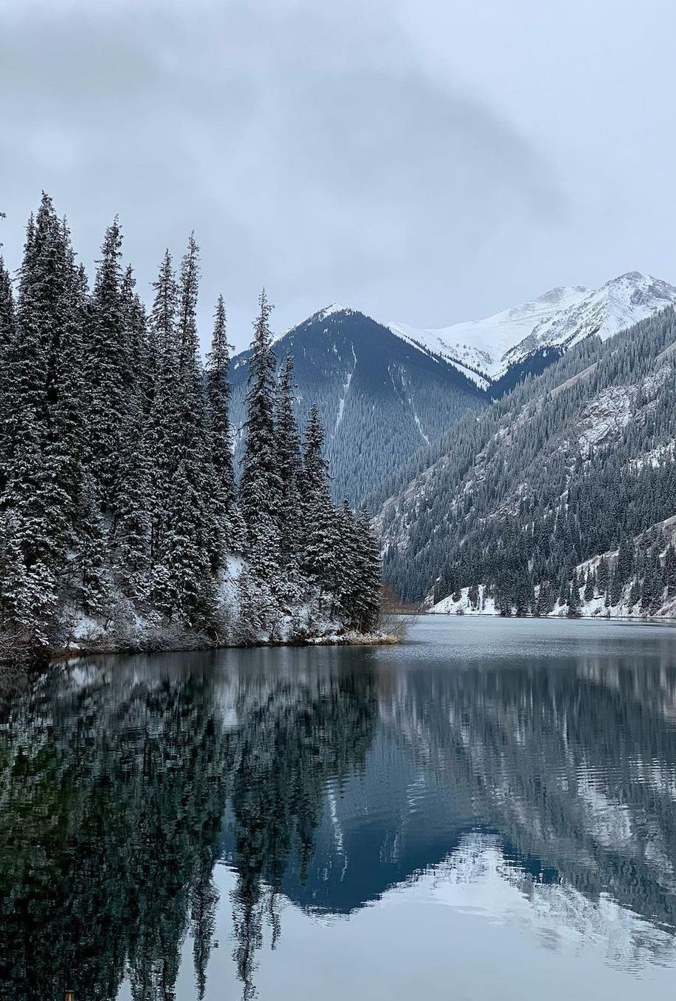
Project description
Mounteam Inc. is an online travel agency owned by Mounteam Group, an Kazakh online travel shopping company based in Almaty. The website and mobile app can be used to book vacation packages and hotel reservations

Slide 3
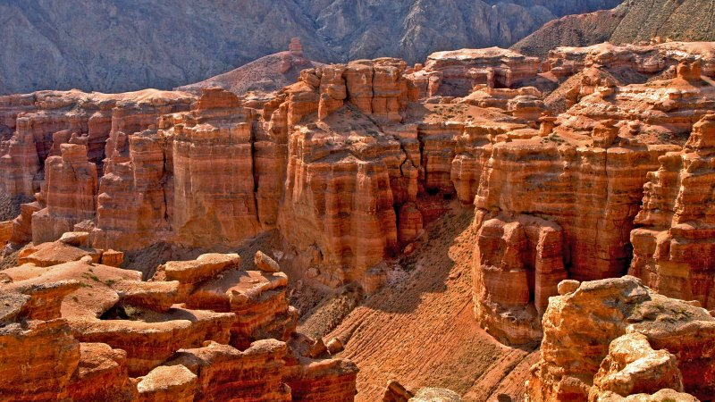
Project relevance
Travel agents are still used for expert guidance, personalized travels, and to save time. The Internet has made it easier to book your own travels, but with that comes informational overload.The value of a travel agent is the ability to provide a personalized travel experience at the right quality and price and most importantly, saving time and energy for their customer.

Slide 4

Responsibility of team members
Tokmurzin Mukagali:backend,report, responsiveness, conntecing JavaScript,sql,php
Tursynbay Aibolat: design, logic of web site, front end, mock up, connecting Bootstrap

Slide 5

Project Features
The first feature of the site is that it is clear to customers, it is very easy and affordable to buy a ticket on the site
The second feature is in the attractive design
The third feature is the direct contact with the seller and consultation

Slide 6
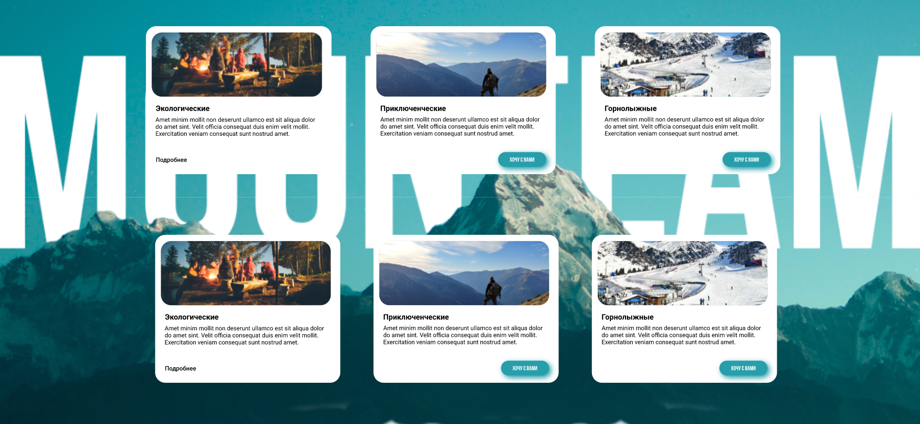
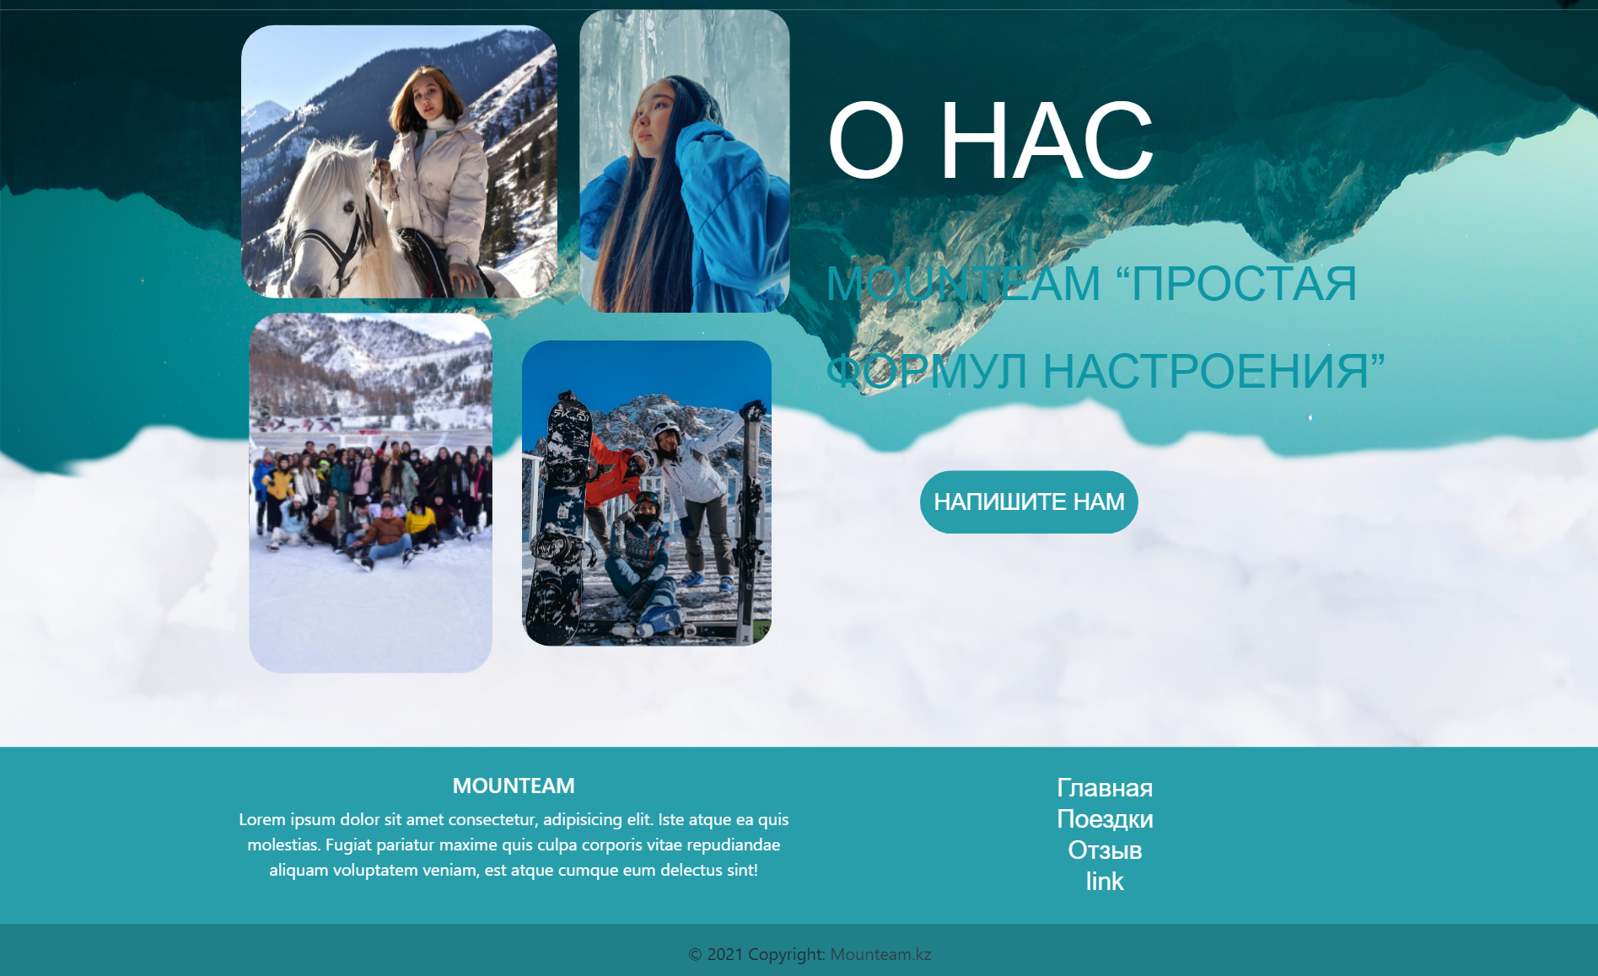

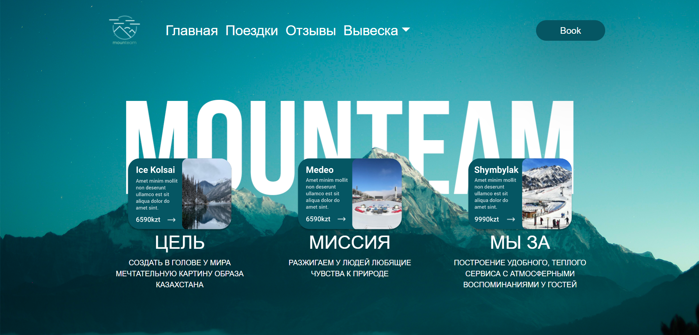
Project Demonstration

